Slide 1
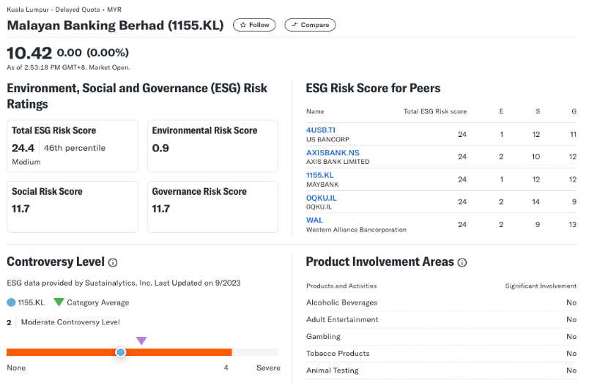
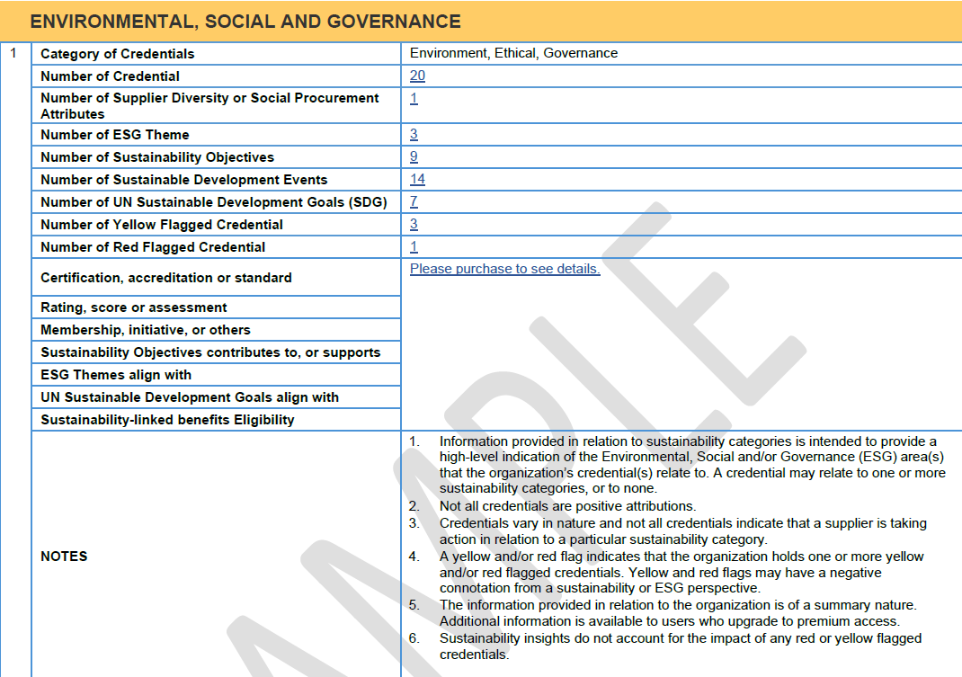
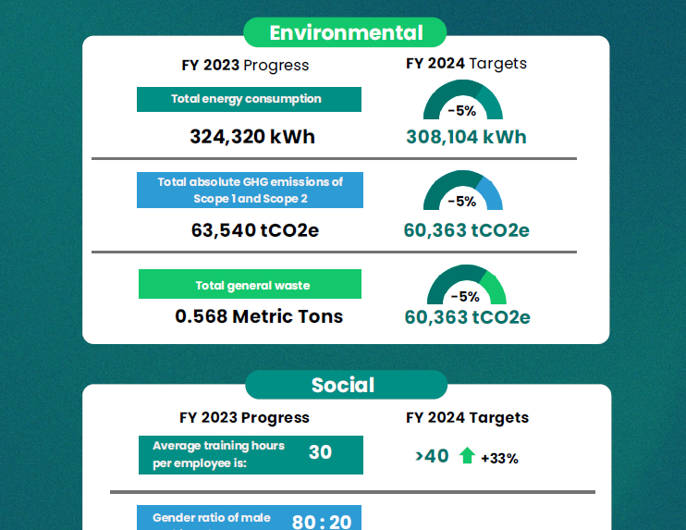
Summary of Identified ESG Data
Yahoo Finance
Experian ESG
ESGpedia
Data Depth
Utilizes Morningstar Sustainability Rating, which assesses company’s ESG performance based on data from Sustainalytics, giving a score relative to its industry peers.
Based on certification, accreditation or standard. Rating, score and assessment based on credentials, such as Sustainalytics ESG Risk Rating and UN Sustainable Development Goals. No transparency to how ratings are derived.
Environmental: Climate-related data, GHG Emissions. Social: Diversity and Equal opportunity, Employment, Occupational Health & Safety, Development & Training, Child & Forced Labor. Governance: Board Composition, Anti-Corruption
Coverage
Public-listed companies
TBC
Private & Public
Description
Basic ESG Scores. Provides snapshot of sustainability risks i.e. Total ESG Risk score, a controversy level indicating reputational risks, and peer comparison to benchmark performance
Centralized ESG summary reports from various ESG data sources. Provides ESG data extraction services where client can provide list of companies, and Experian return the ESG details of the company. All reports available in digital form, embedded into current Experian reports
Comprehensive ESG reports with comprehensive sustainability data, and supply chain ESG insights
Cost
Free, Website/API
Paid (TBC)
In-house
Data Frequency
Periodic updates
Regular updates
On report basis (at point of application)

Slide 2
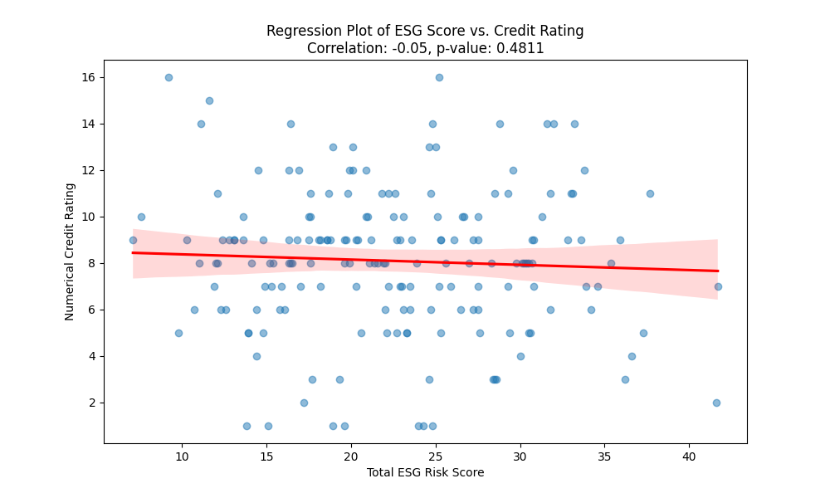
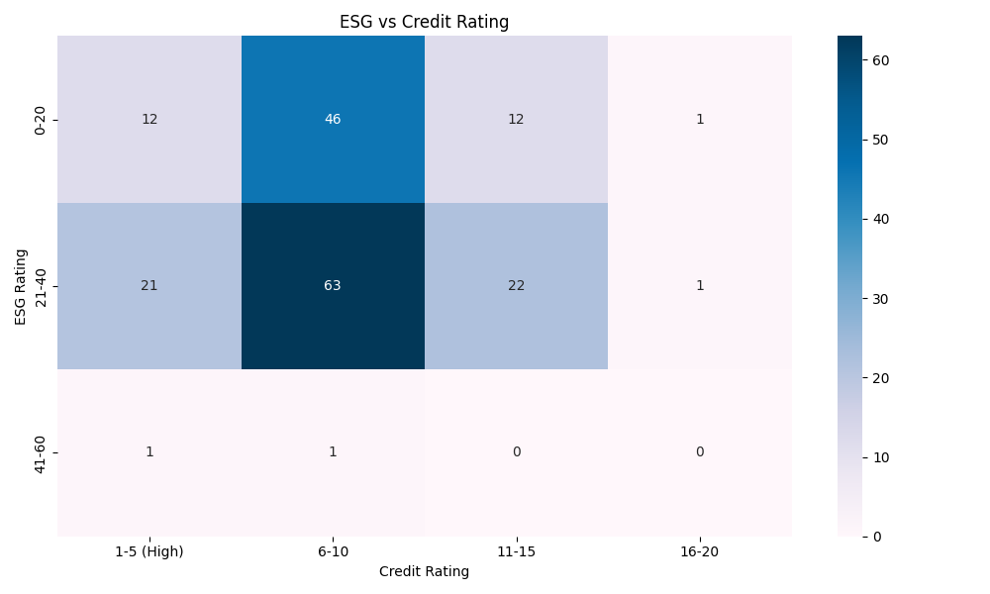
Cross Distribution of customer for credit rating vs ESG score
Dataset (‘combined_data’) includes 181 rows, variables included: ‘Total ESG Risk Score’, (credit) ‘Numerical Rating’) – converted from ‘Rating’
Negative, but low correlation (-0.0528), suggests that higher EGS risk scores associated with slightly lower credit rating
High p-value (0.4811), indicating no statistical significance
No clear trend
Most entities with low ESG scores, between 0-20 and 20-40 fall into the 6-10 credit rating band i.e., medium credit risk rating
Correlation between lower ESG performance and moderate credit risk
Sparse data on top ESG band (41-60)

Slide 3
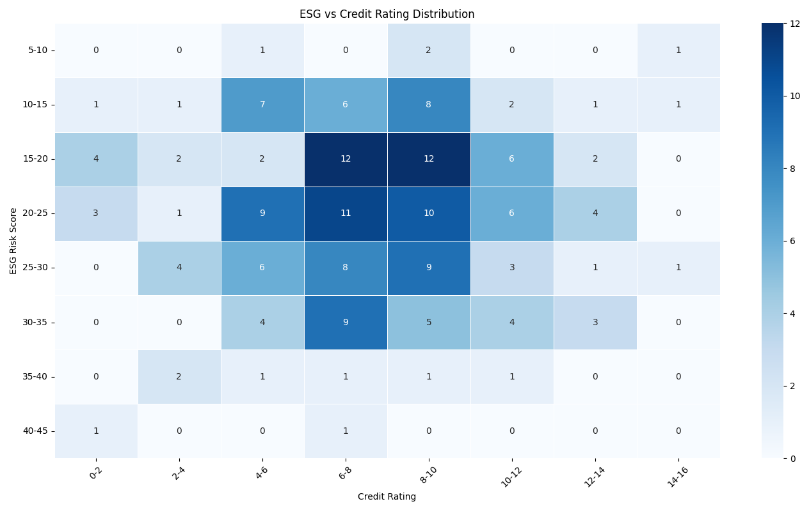
Cross Distribution of customer for credit rating vs ESG score
1. Clusters of High Occurrence:
The highest concentration of data points appears in the 15-20 ESG risk score range and the 6-8 credit rating range.
Other notable concentrations are around the 20-25 ESG risk range and 6-10 credit rating range.
2. Possible Negative Correlation:
As ESG risk scores increase (higher risk), the credit ratings appear to spread across different values instead of staying within a tight range.
The stronger clusters in the mid-range suggest a potential non-linear relationship.
3. Low Occurrences in Extreme Ranges:
Very low ESG risk scores (5-10) and very high ESG risk scores (40-45) have fewer occurrences, suggesting that companies tend to cluster in the moderate ESG risk ranges.
Similarly, extreme credit ratings (0-2 and 14-16) are sparse.

Slide 4
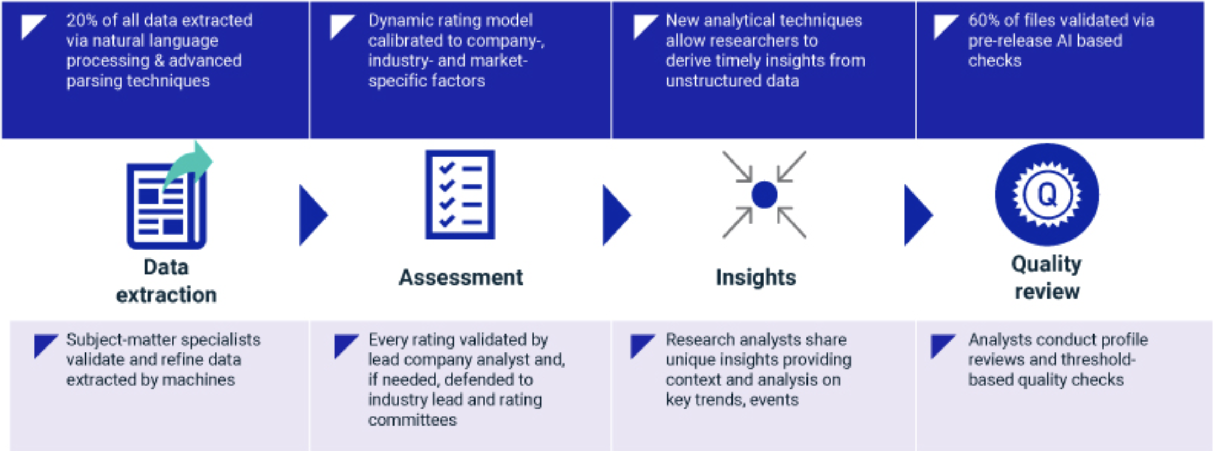
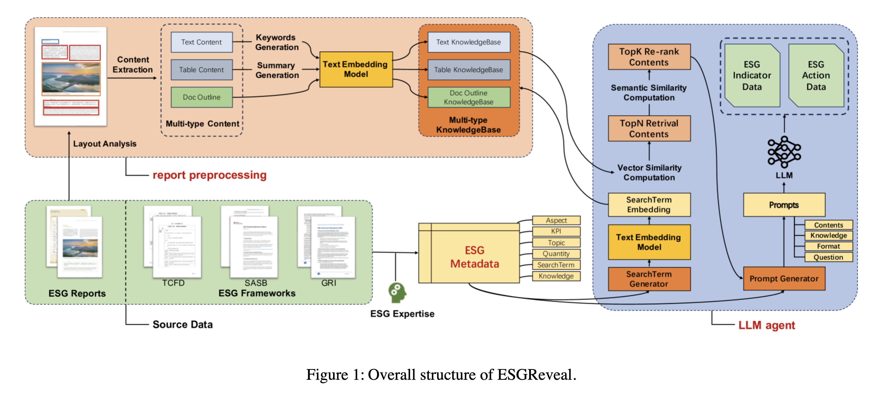
Measuring ESG score using text analysis and LLMs
MSCI uses technology and AI, combined with a team of 200+ ESG analysts, to extract investment-relevant insights from unstructured data.
- Machine learning and natural language processing → increase timeliness and precision of data collection, analysis and validation
Deliver insights not captured with voluntary company ESG disclosures
Identify risks and opportunities not commonly disclosed in traditional data sources
Data input: Corporate ESG reports
Harness sophisticated text processing capabilities of LLMs within RAG paradigm to systematically decompose both numerical and textual information contained in reports from various standard frameworks.
This systematic analysis facilitates deeper insights into ESG disclosure practices.

